Slide 1
Hope IS A 4 LEGGED WORD
Maureen Horgan & Dresden

Slide 3
Learning Objectives
1. Recognize the impact and benefit of a AAA/T program for grieving children, families and hospice/palliative care professionals.
2. Describe AAA/T strategies and interventions for supporting grieving children and families.
3. List the characteristics of a successful therapy dog team and resources for becoming a AAA/T team.
4. Identify the components for developing and implementing an animal assistance activity and therapy program.

Slide 4
History of Animal Therapy
Florence Nightingale 1800’s
Freud and “Jofi” 1930’s
Levison paper @ APA 1960’s
Notes:
Animals have long been part of the human experience, serving multiple purposes throughout history, from food to companionship. More recently, the therapeutic potential of animals in numerous clinical areas has been increasingly recognized, leading to more healthcare facilities providing animal-assisted therapy (AAT) to their patients. In this article, the author provides an overview of the history of AAT, outlines several benefits that are particularly relevant to geriatric patients, and describes how skilled nursing facilities can set up AAT programs, reviewing how to ensure proper animal selection and prevent zoonotic infections. - See more at: http://www.annalsoflongtermcare.com/article/animal-assisted-therapy-exploration-its-history-healing-benefits-and-how-skilled-nursing#sthash.EunGLWQa.dpuf
The therapeutic potential of animals was first recognized in the late 1800s, when Florence Nightingale, considered the founder of modern nursing, made substantial discoveries regarding AAT.⁴ She observed that small pets helped reduce anxiety in children and adults living in psychiatric institutions, and she wrote in her book Notes on Nursing that being with small animals helps patients recover.⁴ Subsequently, AAT grew as a treatment for anxiety and as a way to relax.
During the early 1930s, Sigmund Freud, best known as “the father of psychoanalysis,” became a proponent of AAT when he began using his favorite dog, Jofi, during his psychotherapy sessions.⁸ Freud believed that dogs had a special sense, and he thought that Jofi could signal a patient’s level of tension by how close the dog stayed to the patient. If Jofi stayed right by the patient, he or she was thought to be relatively free of tension, but if he stayed at the other end of the room, the patient was thought to be very tense.⁸Freud would also use Jofi to facilitate communication with his patients. He found that many patients initially felt more comfortable talking through Jofi, and that this interaction served as a stepping stone until they felt comfortable speaking directly to him.⁹ However, Freud’s view on animals’ therapeutic potential did not become apparent until almost two decades after his death, when a series of books were released that included translations of his letters and journals.¹⁰
In the early 1960s, Boris Levinson, a respected child psychotherapist, discovered by chance that a disturbed, nonverbal 9-year-old boy began to communicate when Levinson’s dog, Jingles, sat with them during psychotherapy sessions.¹⁰ He proceeded to observe similar results in other children who had difficulty communicating. Based on his collective experience, Levinson presented a paper at an American Psychological Association meeting, but he was not taken seriously until Freud’s experiences with Jofi came to light.¹⁰Levinson went on to author Pet-Oriented Child Psychotherapy and became known as “the father of AAT.”¹
- See more at: http://www.annalsoflongtermcare.com/article/animal-assisted-therapy-exploration-its-history-healing-benefits-and-how-skilled-nursing#sthash.EunGLWQa.dpuf

Slide 5
Animal Assisted Activity
Notes:
College visits – hospital visitation – reading with rover

Slide 6
Animal Assisted Therapy

Slide 7
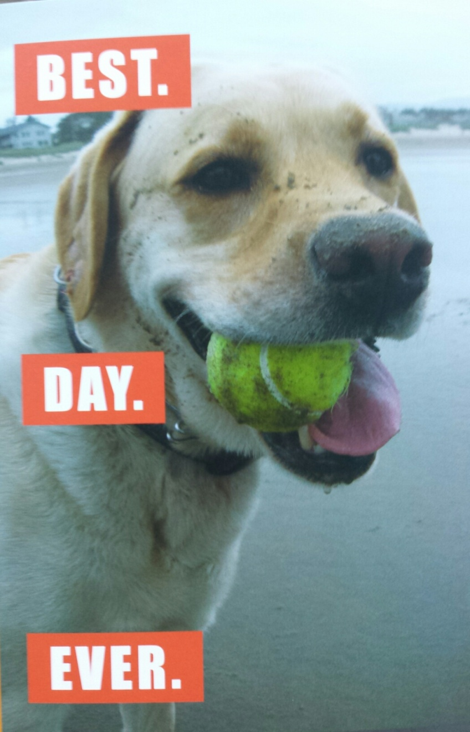
BENEFITS
Psycho Social Goals
Stress reduction
Distraction
Pain management
Life Review
General Coping
Emotional well being
Notes:
Staff – coming to lie by Dres. Playing Ball. Dres “finding” people during meetings – example of John the chaplain. The volunteer mom whose children died
Grieving Children – Sibling of dying child – feeling of control
Agin parent – brings children to vvisit
Life

Slide 8
Benefits
Physical Goals
Stress reduction
Pain management
RestorativeTherapy
Physical
Occupational
Speech

Slide 9
When is AAT helpful?
Hospitals
Geriatric Housing & Clinics
Post Critical Event
Hospice
Therapy Clinics
Court Support
Wounded Warrior Programs
PTSD Clinics
Children’s Camp
Reading Programs

Slide 10
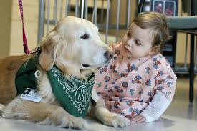
Strategies & Interventions
Notes:
Movement – petting range of motion
Going on walks
Group work
1:1 visiting

Slide 11
Interventions & Activities
Time to Play
Fetch
Hide & Seek
Tricks
Bubbles
Bonding Moments
Life Review
Care Giving
Talking
Crafts

Slide 13
A Successful Team –Selection & Assessment

Slide 14
“Certification” Programs

Slide 15
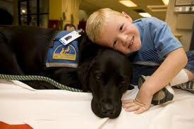
Canine Companions for Independence
Facility Dogs
Companion Dogs
Service Dogs
PTSD Dogs
Hearing Dogs

Slide 16
Creating Program
Recruitment
Policy and Procedure
Volunteer Team in Person
assessment
Joint Visits
Ongoing support and
supervision

