Slide 1
Creating a Safe Space for Bereaved Children
Jen McCormick, LICSW
Clinical Director
The Healing Center

Slide 2
Creating a Safe Space for Bereaved Children: Outline
Overview of children’s grief and developmental stages
Why children need a safe space to grieve
How do we create a safe space?
Exploration of different modalities to facilitate safety
Group themes and the tasks of mourning
Special Considerations: Traumatic Loss, Teens
Experiential and Discussion

Slide 3
Children’s Grief 101
“If you are old enough to love, you are old enough to grieve”
-Alan Wolfelt

Slide 4
Children’s Grief and Development: Overview
Grief is about the absence rather than the concept that person is dead
Perception of the world, including death, is based in the five senses. The word death may not mean anything, although not seeing, hearing, smelling, touching, and feeling the person’s presence does mean something.
Thinking is concrete and based in the present moment. Abstract thinking develops over time.

Slide 5
Children’s Grief and Development: Overview, cont.
Information is processed from specific to general. Example: If grandma died in the hospital, all people die in hospitals.
Grief is repetitive. Children will ask to hear the story of death over and over, and will ask questions until they are able to fill in the gaps in their understanding to their satisfaction.
Grief is physical. Verbal articulation develops with age, but young children express themselves through play, art, and movement.
Notes:
Not going to sit and have a conversation, but will see lots of feelings and thoughts come out in play. Use example of child that sets up hospital scene in sand tray because dad died in the hospital after mom had to make the decision to stop life support.

Slide 6
Children’s Grief and Development: Overview, cont.
Grief is expressed in spurts. Children may not have an instant grief reaction. They may feel sad for a moment and laugh and play the next moment.
Children grieve as part of a family. The way the family dynamic is impacted after a death will be reflected in child’s behavior. The person who died is lost, and so is the role of that person in the child’s life.
Notes:
Children might ask harder questions like who will take care of me to simpler questions like who will make cookies with me?

Slide 7
Children’s Grief and Development: Breakdown by Age
Grief is cyclical. There is no “end” to grief, only changes over time. Children will revisit different aspects to their grief as they reach new developmental milestones.
Notes:
As a child moves into a new developmental stage, they will have more and different questions about the death.

Slide 8
Age: 18months-3 years
Think:
-Illness and death is temporary and reversible
-Fantasy and reality not separated
-Has short-term memory
Feel:
Sad, anxious, confused, angry, scared, cranky
Do:
-Imitates behaviors
-Asks why

Slide 9
Age: 3-5 years
Think:
-Death is temporary and reversible
-May confuse death with taking a trip or sleeping
-Finality of death is not evident
-May wonder what deceased is doing
Feel:
Sad, anxious, confused, scared cranky, angry
Do:
-Cry
-Fight
-Are interested in dead things
-Act as if death did not happen

Slide 10
Age: 6-9 years
Think:
About the finality of death
About the biological process of death,
Death is related to mutilation
A spirit gets you when you die
About who will care for them if a parent dies
Their actions and words caused the death.
Feel:
Sad
Anxious
Withdrawn
Confused about changes
Angry
Scared
Cranky
Do:
Behave aggressively
Behave withdrawn
Experience nightmares
Act as if death never happened
Lack concentration
Have a decline in grades.

Slide 11
Age: 9-12 years
Think:
About and understand the finality of death
Death is hard to talk about
That death may happen again, and feel anxious
About what will happen if their parents) die.
Their actions and words caused the death.
Feel:
Vulnerable
Anxious
Scared
Lonely
Confused
Angry
Sad
Abandoned
Guilty
Fearful
Worried
Isolated
Do:
Behave aggressively
Behave withdrawn
Talk about physical aspects of death
Act like it never happened, not show feelings
Experience nightmares
Lack concentration
Have decline in grades

Slide 12
Age: 12+
Think:
About and understand the finality of death.
If they show feelings they are weak.
They need to be in control of their feelings.
About death with jocularity
Only about life before or after death
Their actions and words caused death
Feel:
Vulnerable
Anxious
Scared
Lonely
Confused
Angry
Sad
Abandoned
Guilty
Fearful
Worried
Isolated
Do:
Behave impulsively
Argue, scream, fight, allow themselves to be in dangerous situations.
Grieve for what might have been
Experience nightmares
Act like it never happened
Lack concentration
Have a decline in grades.

Slide 13

Creating a Safe Space for Every Age and Stage

Slide 14
Why do bereaved children need a safe space?
The loss impacts all aspects of a child’s life:
“In fact, young children’s grieving for a lost parent affects every aspect of their functioning and development, with the negative effects mitigated only when surviving adults close to them provide sufficient support.”
Doka, Kenneth J.and Webb, Nany Boyd. Helping Bereaved Children, Third Edition: A Handbook for Practitioners (Social Work Practice with Children and Families). The Guilford Press. November 2011. Kindle Edition.

Slide 15
Why do bereaved children need a safe space?
Children often feel alone in their loss. Creating a safe place facilitates healing:
“Children do not like feeling different from peers and respond positively to being in the company of others who are experiencing similar situations (Bacon, 1996; Glazer & Clark, 1999; Webb, 2002). Being one among many whose lives have been disrupted by the death of a loved one helps the child begin the process of normalizing grief and integrating the loss into everyday life. “
Doka, Kenneth J.and Webb, Nany Boyd. Helping Bereaved Children, Third Edition: A Handbook for Practitioners (Social Work Practice with Children and Families). The Guilford Press. November 2011. Kindle Edition.

Slide 16
Why do bereaved children need a safe space?
After a loss, the child’s remaining natural support system is inadequate.
“At a time when a child’s need for parental attention has never been greater, a parent who is lost in grief has little energy to recognize and attend to the emotional needs of a grieving child.”
Doka, Kenneth J.and Webb, Nany Boyd. Helping Bereaved Children, Third Edition: A Handbook for Practitioners (Social Work Practice with Children and Families). The Guilford Press. November 2011. Kindle Edition.

Slide 17
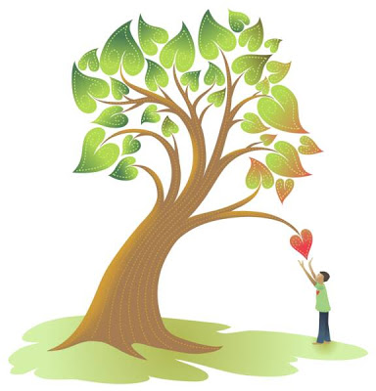
What Grieving Kids Want You to Know
I deserve to be informed and included
I might not feel or act the way you want or think I should
I don’t want to feel like the only person I know who has lost someone
My feelings change over time
I want to play and laugh and not just be sad

Slide 18
So…how do we create a safe space?
By creating different modalities within which children can express their grief in a developmentally appropriate and therapeutic manner.

Slide 19
So…how do we create a safe space?
By creating different modalities within which children can express their grief in a developmentally appropriate and therapeutic manner.
Group time is an ideal opportunity for providing various modalities.

Slide 20

Community Time
“You can’t hurry love or pizza. Especially pizza.”
-Snoopy

Slide 21
Establishing Rules for Safety
You can always pass
It’s OK to laugh and OK to cry
One person talks at a time (talking stick)
Respect self and others
No harm to others or objects
Confidentiality
If it’s wet and it’s not yours, don’t touch it
Three people in the stuffy room!
Be with or close to a grown-up at all times

Slide 22

Opening Circle: Witness and Normalize
“Being an empathic witness to the emotional pain of peers boosts a child’s self-esteem and aids participation in the group activities.”
(Doka, Kenneth J.and Webb, Nany Boyd. Helping Bereaved Children, Third Edition: A Handbook for Practitioners (Social Work Practice with Children and Families). The Guilford Press. November 2011. Kindle Edition.

Slide 23

Opening Circle: What happens?
During opening circle, children have a chance to introduce themselves and name the person that died. They can light a candle for their person if they choose.

Slide 24
Opening Circle: Introducing Theme
Initially, groups are set-up so children can get to know one another and establish safety.

Slide 25
Opening Circle: Introducing Theme
Initially, groups are set-up so children can get to know one another and establish safety.
Later on, group curriculum is designed based on themes that address Worden’s Four Tasks of Mourning.

Slide 26
Worden’s Four tasks of Mourning
Accept the reality of the loss
Work through the pain of grief
Adjust to a world in which the deceased is missing
Find a lasting connection with the deceased while embarking on a new life

Slide 27
Opening Circle: Getting to Know One Another
Group curriculum is based on sharing stories and feelings.
Activities include:
  M & M Game
  Dog Gone Grief
  UnGame
  Interviews
  This type of group typically occurs in the beginning of the school year, but can be reintroduced as new members join group.

Slide 28
Task: Accept Reality of the Loss
Group themes are centered around understanding what death is.
Activities include:
  What does death look like?
  Doctor visit to answer questions about illness and death.
  Reading books that describe the concept of death.

Slide 29
Task: Work Through the Pain of Grief
Group themes are centered around feelings.
Activities include:
  Fishing for feelings
  Body tracing with feelings
  Feelings Bingo
  Books about feelings and loss

Slide 30
Task: Adjust to a world in which the deceased is missing
Group Themes are centered around unique experience of grief.
Activities include:
  Inside Outside Masks
  Grief is Like a Snowflake
  Mixed Up Feelings Jar
  Books centered around the feeling of missing the person that died.

Slide 31
Task: Finding a Lasting Connection with the Deceased while Embarking on a New Life
Group Themes are centered around commemoration and healing
Activities include:
  Memory Boxes
  Broken Heart Quilt
  New Year’s Wishes Mobile
  Books that address lasting connections with the deceased.
Notes:
The Invisible String, The Missing Piece,

Slide 32
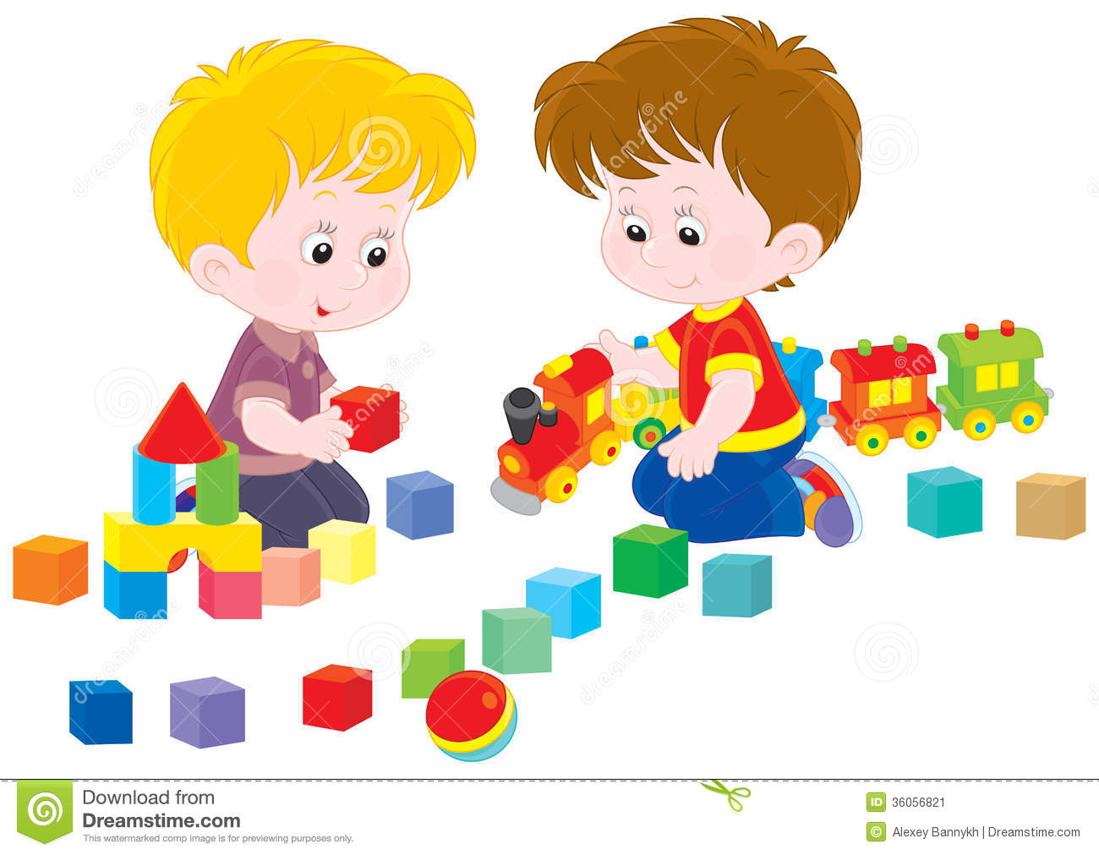
Can we go upstairs now???
Supported Play Time
“ The discovery of self and other is discovered through play (Winnicott), and through this play the child has the freedom to explore his or her struggles and frustrations of the various roles and situations he or she has encountered and might be fearful of and gain some form of mastery or healing.”
Schaefer, Charles and Kaduson, Heidi. Contemporary Play Therapy: Theory, Research, and Practice. The Guilford Press, 2006.Print.

Slide 33
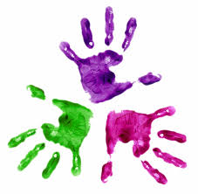
Modalities within Free Play Time
During free play, children are given many different ways to express themselves. The role of the clinician or volunteer is to follow the child’s lead. This allows the child to feel in control and safe to grieve.
Modalities within free play time include:
-Stuffy Room
-Sand Tray
-Toy Room
-Art Room
-Dress Up

Slide 34

Art Room
A project that correlates with the group theme is always available
Children are never asked to only complete the project, but instead are encouraged to do whatever they feel like in the art room.
All art supplies and ideas are readily available for children to access during free play time.
Notes:
I am not a licensed art therapist

Slide 35

Art as a Non-Verbal Modality
“Using visual images to enhance processing of emotional experiences can be extremely helpful. First, visual images engage the brain’s left hemisphere, bypassing language centers and facilitating new emotional observations and connections.” –Schaefer, Charles and Kaduson, Heidi. Contemporary Play Therapy: Theory, Research, and Practice. The Guilford Press, 2006.Print.
Art is a way to access the
grief process for kids that
don’t feel safe talking.

Slide 36
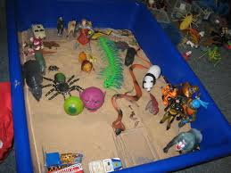
Sand Tray:
Symbolic Play Modality
Sand tray therapy gives expression to nonverbalized emotional issues. If play is the language, then the miniatures (in the sand tray) are the words. *
Sand tray therapy serves to create a necessary therapeutic distance.*
Sand tray therapy provides natural boundaries and limits.*
It is effective in overcoming resistant clients: kids are never self-referred to The Healing center, sand tray can draw in quiet and resistant kids
The sand tray is a good place to experience control over your environment.*
*Homeyer, Linda and Sweeney, Daniel. Sandtray Therapy: A Practical Manual. Second Edition. Taylor & Francis Group, 2011. Print.

Slide 37
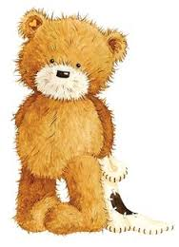
Symbolic Play Modalities, Cont.
Toy Room
Stuffy Room
Dress-Up

Slide 38
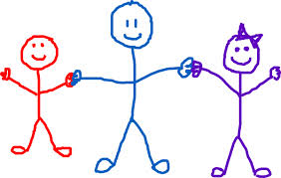
Closing Circle
3 minute safety stop
What did you enjoy today?
Would you like to share your art?
Laughter, stretching, the big squeeze

Slide 39
Special Considerations: Traumatic Loss
Children who have experienced a traumatic loss are in same bereavement group with others
(Doka, Kenneth J.and Webb, Nany Boyd. Helping Bereaved Children, Third Edition: A Handbook for Practitioners (Social Work Practice with Children and Families). The Guilford Press. November 2011. Kindle Edition.
Notes:
Give examples: burying in stuffy room, hospital scene in sandtray

Slide 40
Special Considerations: Traumatic Loss
Children who have experienced a traumatic loss are in same bereavement group with others
Children with this type of loss have been observed to engage in more symbolic play and less circle time contributions
(Doka, Kenneth J.and Webb, Nany Boyd. Helping Bereaved Children, Third Edition: A Handbook for Practitioners (Social Work Practice with Children and Families). The Guilford Press. November 2011. Kindle Edition.
Notes:
Give examples: burying in stuffy room, hospital scene in sandtray

Slide 41
Special Considerations: Traumatic Loss
Children who have experienced a traumatic loss are in same bereavement group with others
Children with this type of loss have been observed to engage in more symbolic play and less circle time contributions
“Symbolic play allows us to view what the child is thinking and understand what he or she knows about the events surrounding the death, giving us the opportunity to clarify confusion and intervene appropriately. When a child witnesses a violent death, that child during play may repeatedly and unconsciously reenact a part of the experience in an effort to self-soothe, lessen the feelings of helplessness, and ease the extreme emotional trauma.”
(Doka, Kenneth J.and Webb, Nany Boyd. Helping Bereaved Children, Third Edition: A Handbook for Practitioners (Social Work Practice with Children and Families). The Guilford Press. November 2011. Kindle Edition.
Notes:
Give examples: burying in stuffy room, hospital scene in sandtray

Slide 42

Special Considerations: Teens
Excerpt from “The Fault in Our Stars”…
Dr. Maria: Have you been going to that support group I suggested?
Hazel: Yeah, it's not my thing.
Dr. Maria: Support group's gonna be a great way for you to connect with people who are...
Hazel: Who are...what?
Dr. Maria: On the same journey.
Hazel: "Journey?" Really?
Dr. Maria: Give it a chance. Who knows? You might even find it enlightening.

Slide 43
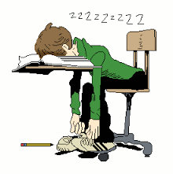
Special Considerations: Teens
Teen Curriculum is tweaked to respect the developmental stage of children 12+.

Slide 44
Age: 12+
Think:
About and understand the finality of death.
If they show feelings they are weak.
They need to be in control of their feelings.
About death with jocularity
Only about life before or after death
Their actions and words caused death
Feel:
Vulnerable
Anxious
Scared
Lonely
Confused
Angry
Sad
Abandoned
Guilty
Fearful
Worried
Isolated
Do:
Behave impulsively
Argue, scream, fight, allow themselves to be in dangerous situations.
Grieve for what might have been
Experience nightmares
Act like it never happened
Lack concentration
Have a decline in grades.

Slide 45
Special Considerations: Teens
Teens are given more autonomy to create buy-in to group
Curriculum is discussed and approved by teens
Activities include journaling, book club, games

Slide 46

Let’s Play!
Please divide into 3 groups
Spend 5-10 minutes at each station
When finished, consider the following discussion questions:
How did each modality feel?
Which did you prefer?
Which do you think would work best with each age group?

Slide 47

Questions/Discussion

